Slide 1

Predicting Opioid Addiction Likelihood Using Neural Nets
Sam Blumer
Practicum II
Regis University

Slide 2
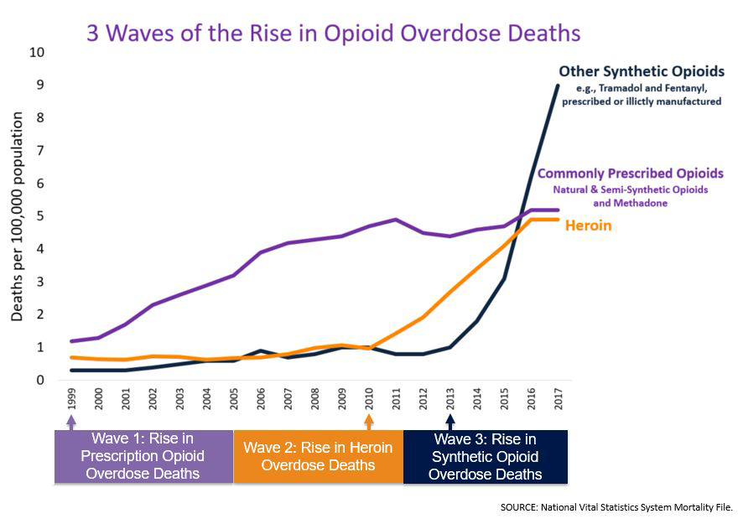
Opioid Addiction in the United States
From 1999 to 2017, more than 700,000 people have died from a drug overdose.
Around 68% of the more than 70,200 drug overdose deaths in 2017 involved an opioid.
On average, 130 Americans die every day from an opioid overdose.
Source: https://www.cdc.gov/drugoverdose/epidemic/index.html

Slide 3
Data Science Process
Data Gathering
Data pre-processing
Data Exploration
Feature Engineering
Model building
Model refining
Model Results
Make Predictions
Prediction Results
Conclusion

Slide 4
Data Sources
National Institute on Drug Abuse
US Department of Health and Human Services
US National Library of Medicine
Institute for Social Research at the University of Michigan
American Association of Nurse Anesthetists
The Foundation for AIDS Research
The Treatment Episode Data Set -- Admissions (TEDS-A) is a national census data system of annual admissions to substance abuse treatment facilities. TEDS-A provides annual data on the number and characteristics of persons admitted to public and private substance abuse treatment programs that receive public funding.
Notes:
Took really 3-4 weeks to gather all data.

Slide 5

Pre-Processing
Use Sparklyr for processing
Import files
Aggregate and flatten files
Update data types
Missing Data
Source: https://spark.rstudio.com/guides/data-lakes/

Slide 6
Data Exploration
Overdose Deaths Over Time
Demographic Characteristics
Substance Abuse Traits

Slide 7
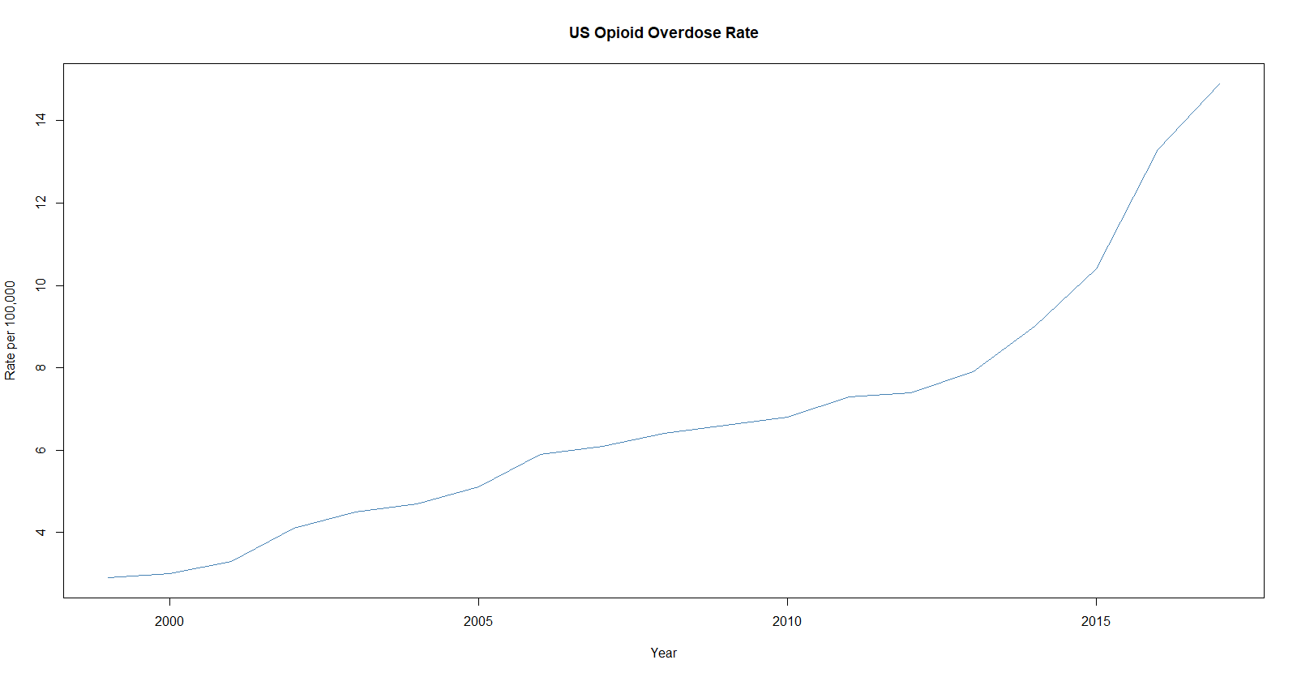
Overdose rates between 1999-2015
Increased OD rates across the board, more prominent in Midwest countries like WV, OH, and MI.
Source: Henry J Kaiser Family Foundation

Slide 8
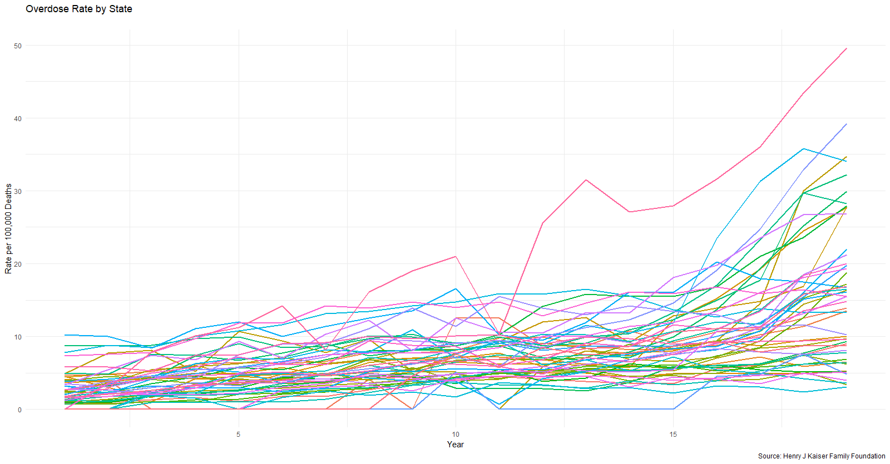
Overdose rates between 1999-2015
Increased OD rates across the board, more prominent in Midwest countries like WV, OH, and MI.
Source: Henry J Kaiser Family Foundation

Slide 9
Overall Admission Data

Slide 10
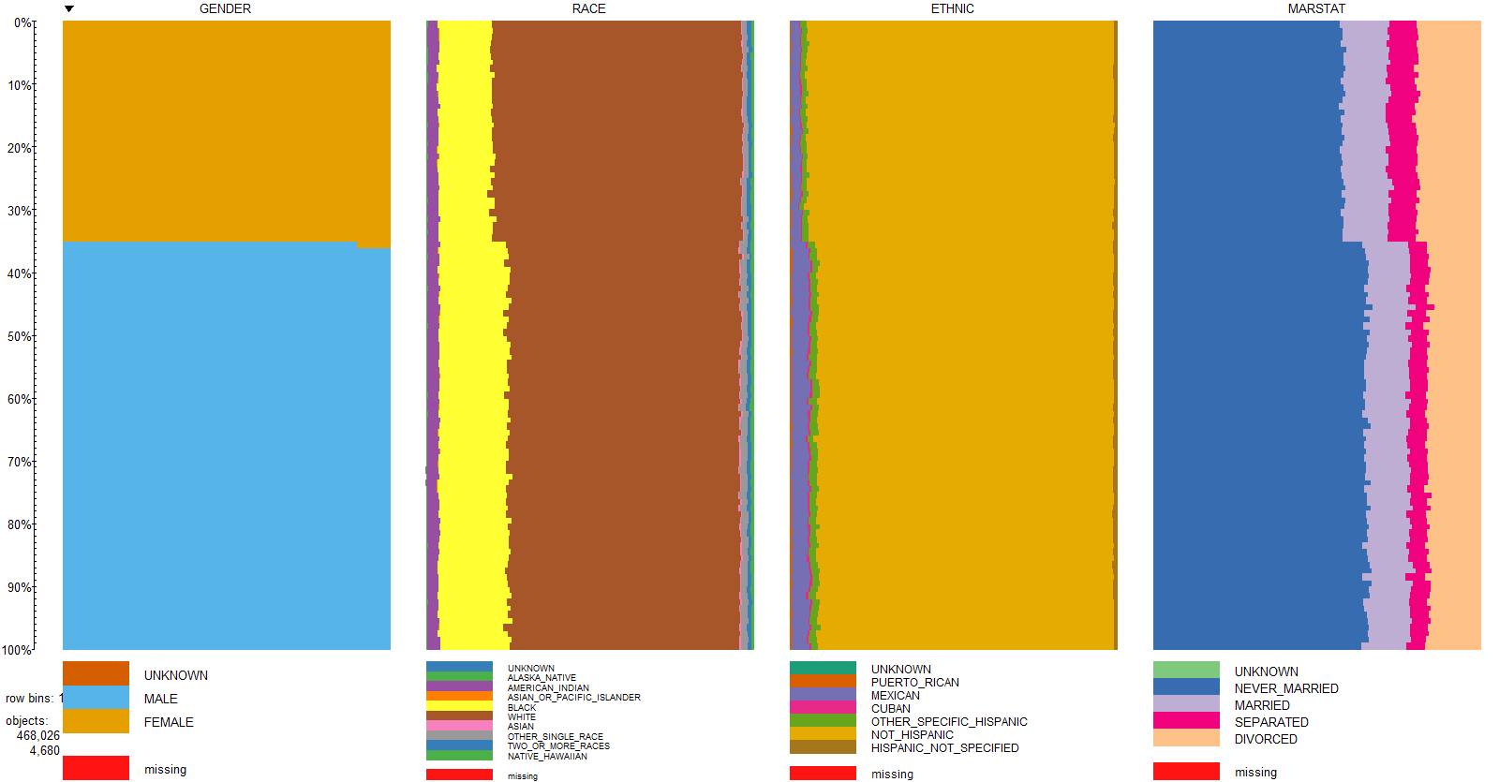

Slide 11
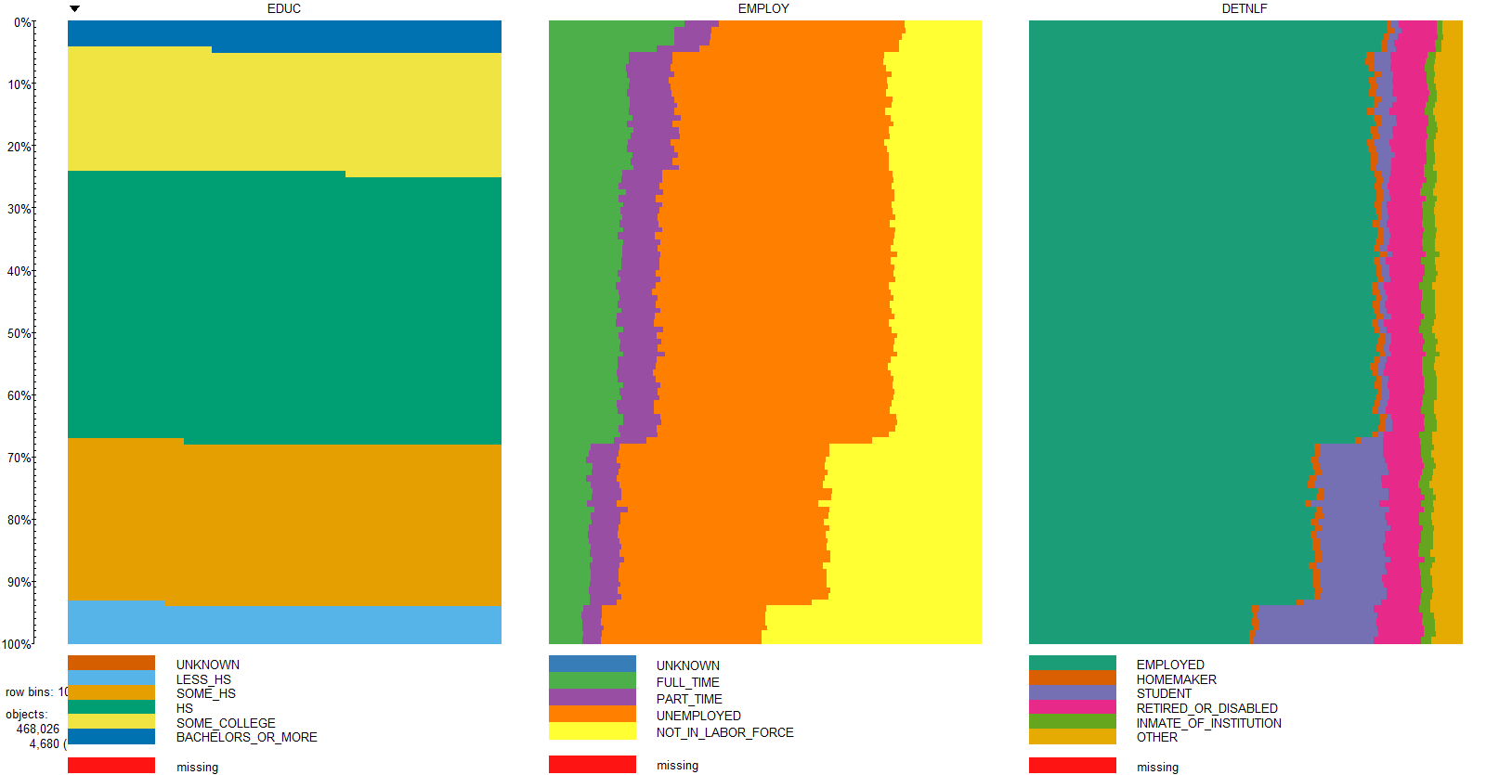

Slide 12
Admission Data for Opiate Users

Slide 13
Demographic Data for Opiate Admission

Slide 14
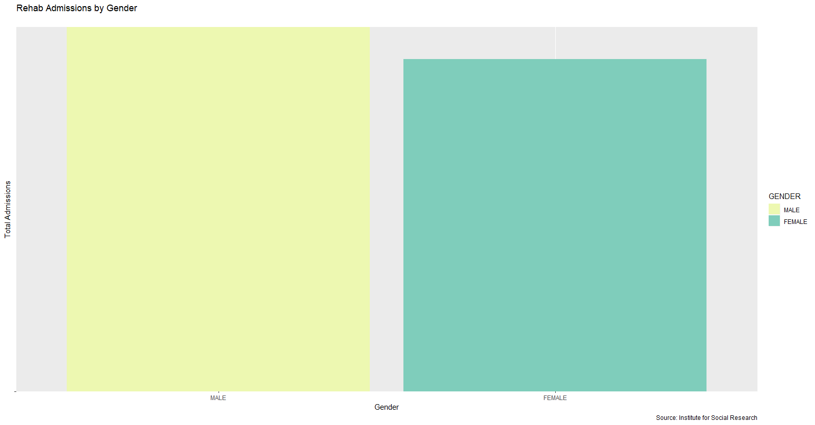

Slide 15
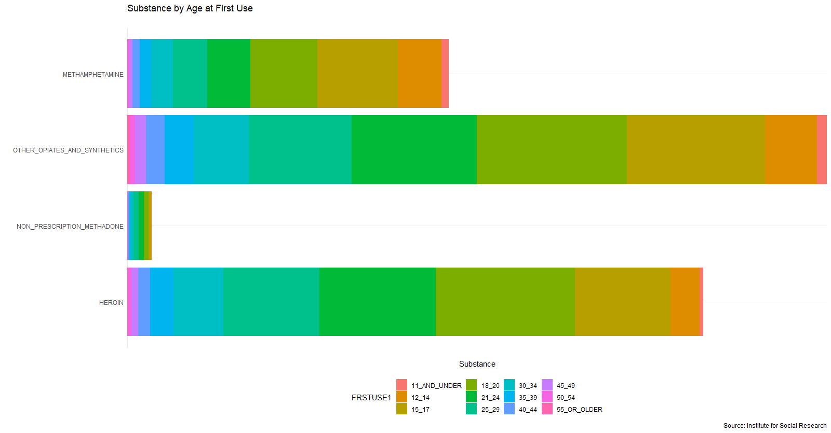

Slide 16
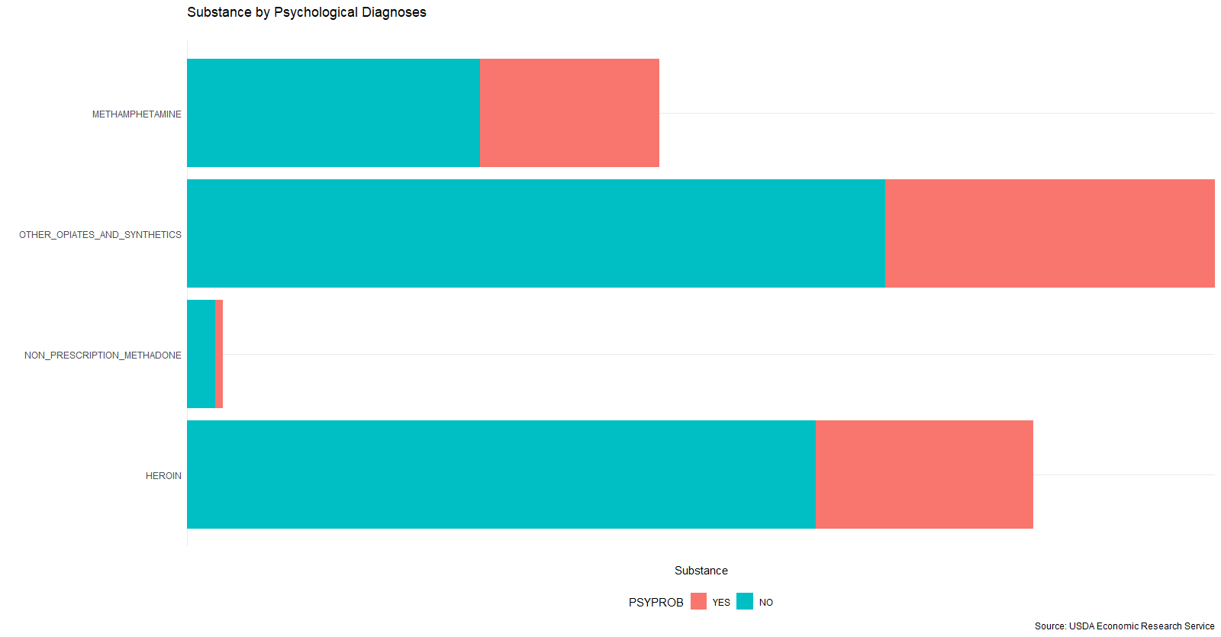

Slide 17
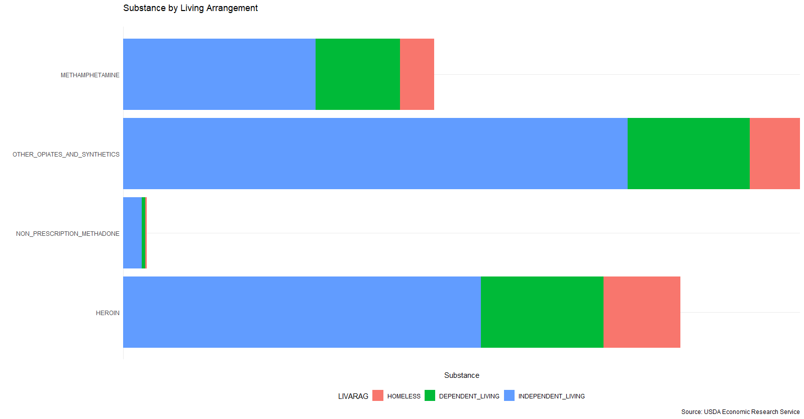

Slide 18
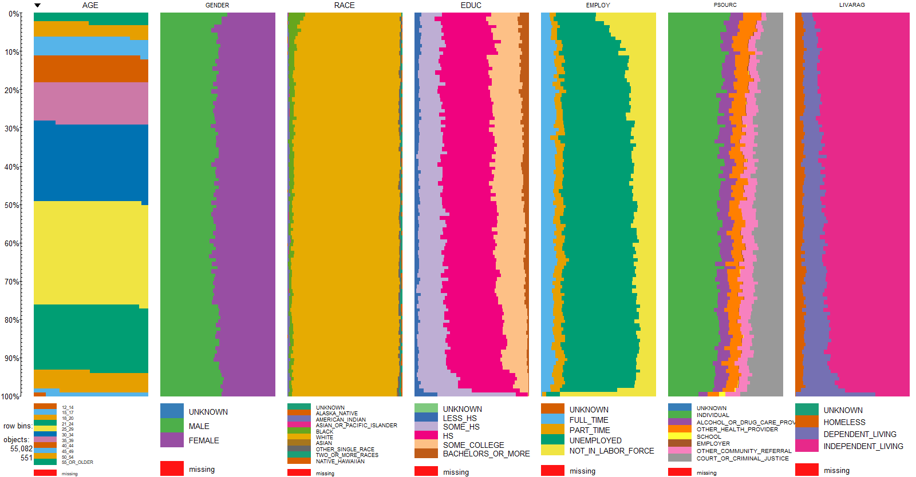

Slide 19
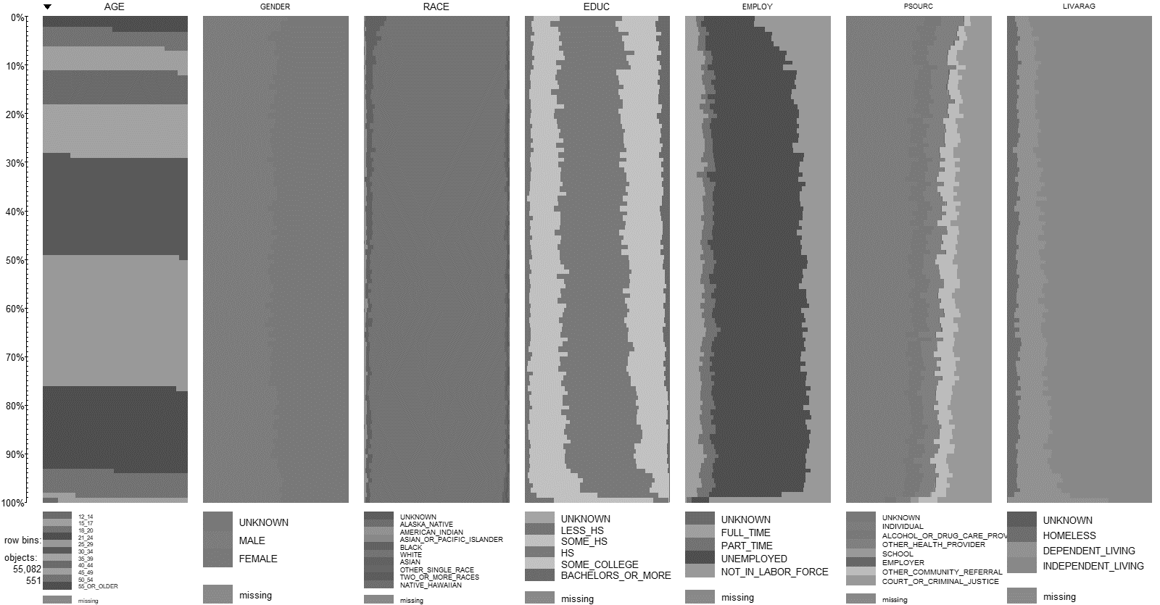
Opiate User Summary
While all substance admission data tended to have twice the number of males, strictly opiate users tended to be equally female and male.
White
Unemployed
High School Education
Independent Living
Started using between 15 – 24

Slide 20
Feature Engineering
30 Initial Variables
1 response (Opioid Abuse Diagnoses per DSM)
29 predictors
Use of One-Hot Encoding
Turns each categorical variable into its own column
181 total variables
1,749,767 x 181 = 316,707,827 total data points
REMOVE ROWS WITH ANY UNKNOWN VALUES (CAN’T IMPUTE FACTORS)
468,026

Slide 21
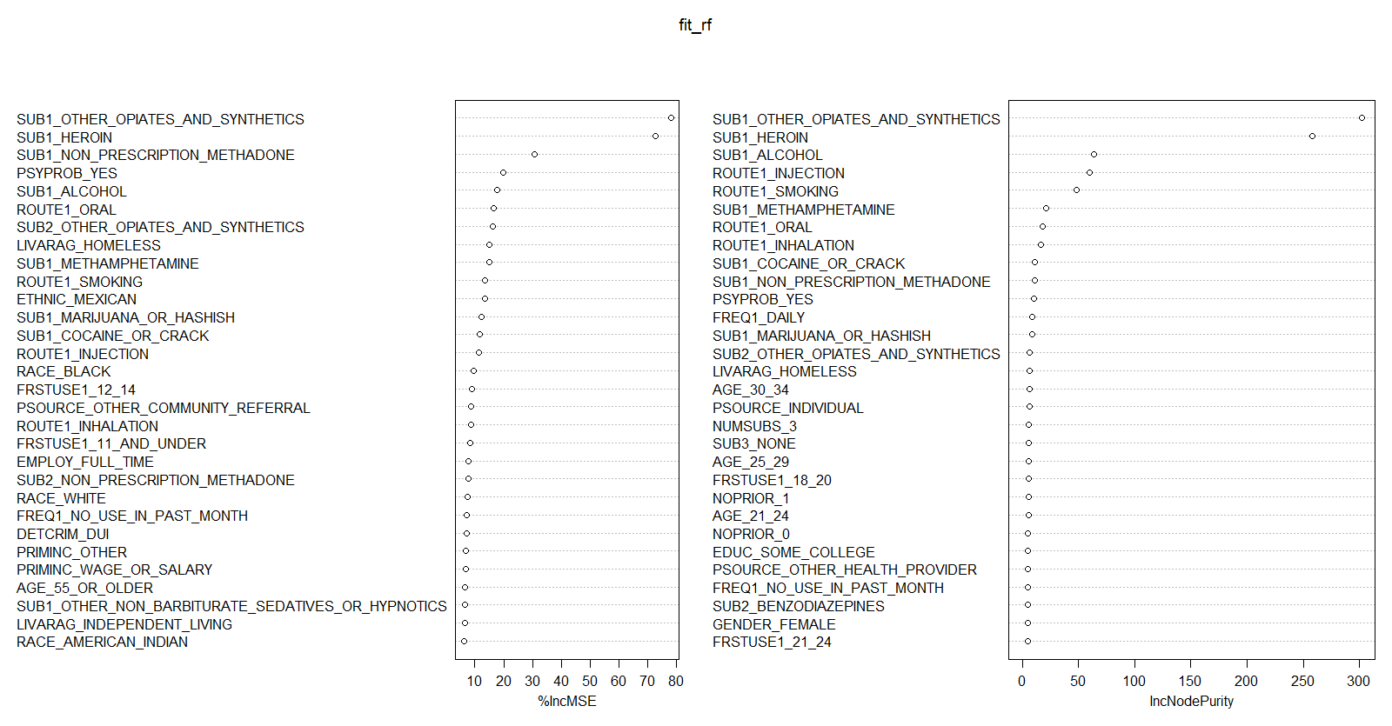
Random Forest Variable Importance
Notes:
The first graph shows that if a variable is assigned values by random permutation by how much will the MSE increase. So in your case if you randomly permute the year (i.e. an observation which had year =2014 but you randomly assign the year = 2012 (if that is present in your bagged sample) and so on) the MSE will increase by 100% on an average. Which make sense that bike demand may have increased in recent years. Higher the value, higher the variable importance.

Slide 22
Model Building
What did we use
NN1: 2-Hidden Layers - Layer-1: 1-neuron, Layer-2: 1-neuron
NN2: 2-Hidden Layers - Layer-1: 2-neurons, Layer-2: 1-neuron
NN3: 2-Hidden Layers, Layer-1: 2-neurons, Layer-2: 2-neurons
NN4: 2-Hidden Layers, Layer-1: 1-neuron, Layer-2: 2-neurons

Slide 23
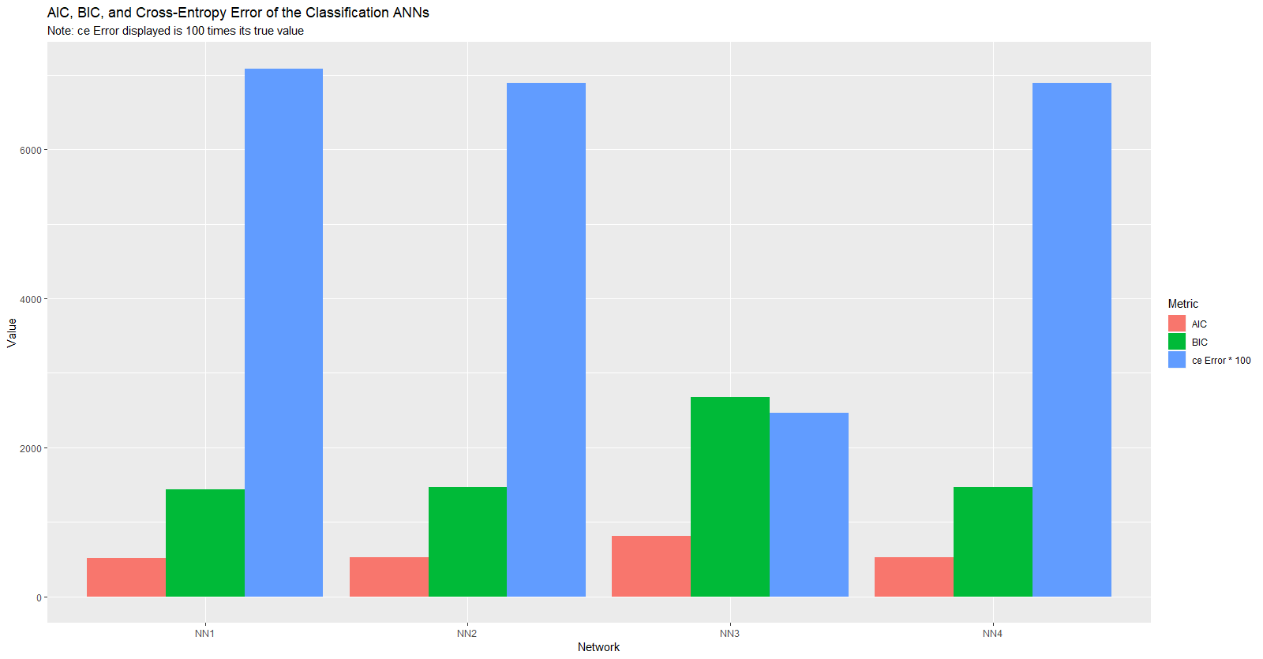

Slide 24
Model Results (NN3)
Accuracy = (1520 + 358)/2000 = .94
Recall = 1520 / (1520 +38) = .98
Precision = 1520 / (1520 + 84) = .95
 | Predictions
Actuals | 0 | 1
0 | 1,520 | 84
1 | 38 | 358

Slide 25
Conclusion
Overall, we were able to identify that with 59 predictor variables, we were able to most accurately predict food deserts with a 75% accuracy rate. When using this same random forest model to predict potential food deserts based off 2015 data, we found that our results were consistent with initial exploratory findings, including:
Food Deserts tend to consist of people of:
Low Income
Low Education
Employment in Manufacturing and Agriculture
White
In addition, we found that Rural areas, including those that lost population between 2011 and 2015, tend to have a higher likelihood for containing a food desert.

